Slide 1
Team Alpha – Prakhar Mithal, Abhinav Gupta
IIT (BHU) Varanasi

Slide 2



PREDICTING SURVIVAL PROBABILITY : A MUST
USE CASES
IMPACT
ABOUT
ABOUT
Predicting Survival Outcome
Predicting the time until Safety

Slide 3


HIGH FALSE POSITIVE RATE : AN EVIL
USE CASES
ABOUT
IMPACT
ABOUT
Predicting Survival while the person actually dies is the WORST
Having Better Precision and Recall is a WIN WIN

Slide 4
ACTIONABLE INSIGHTS : THE FUTURE
USE CASES
Recommending additional Vitals to improve Survival chances
ABOUT
IMPACT
ABOUT
Prevents Inaccurate and delayed diagnosis

Slide 5



1
2
USE CASES
ABOUT
IMPACT
ABOUT
Dr. KIM
Medical practitioner at a multi-speciality hospital.
Measures the survival probability of the patient, get actionable insights for better diagnosis.
ELSA
Elsa is a 70 year old woman.
Elsa can take self-care by tracking her health in real time.

Slide 6
250,000
DEATHS
7.5%
increase
80%
30%
REASONS
Due to medical errors
Third leading cause of death.
RISK OF DEATH
For each 30 min of delayed diagnosis.
LIVES SAVED
With the help of Rapid diagnosis and treatment
REDUTION IN COSTS
Household costs that goes into medical issues.
Leads to cost reduction which would help us
USE CASES
ABOUT
IMPACT
ABOUT

Slide 7
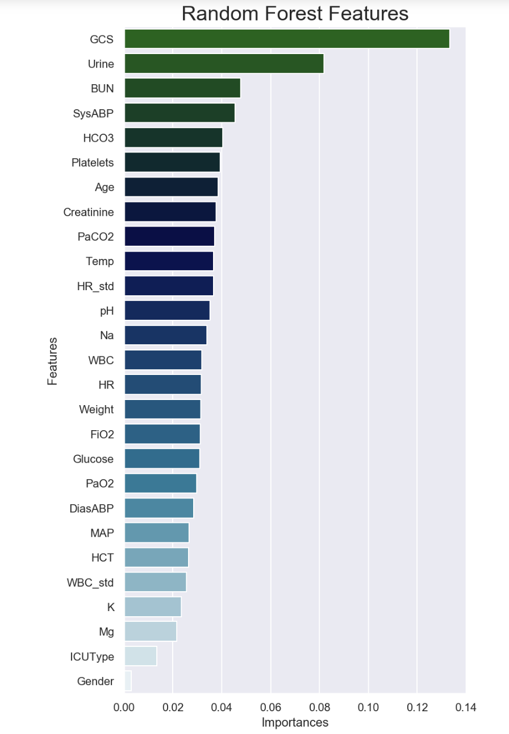




MODEL ACHITECTURE
ACTIONABLE INSIGHTS GENERATION
MODEL EVALUATION : THE METRIC
INPUT(Patient Vitals)
Classification of Mortality Outcomes : How ?
Most of the patients survive, the distribution is skewed
Vital Selection Module
F1 Score and Area Under ROC Curve are better metrics
C
Use Machine Learning
B
Leveraging the minute details of the data
Imputation Module
A
Prediction Module
Survival Probability
Time until Safety
Actionable Insights
Output missing features sorted in order of feature importance
Feature importance calculated using the model heuristics

Slide 8
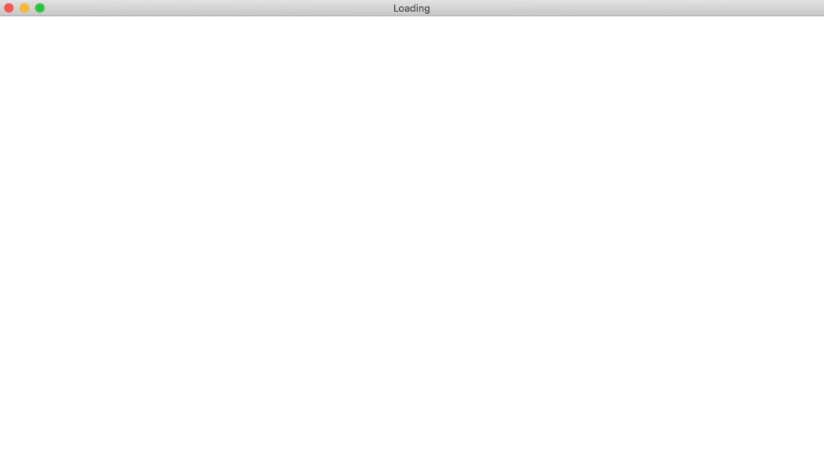

Slide 9
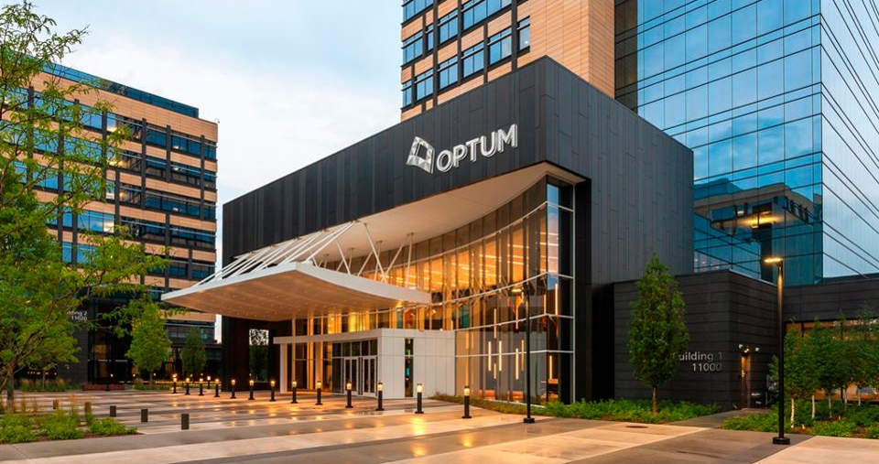
THANK YOU
Prakhar Mithal
Abhinav Gupta

Slide 10
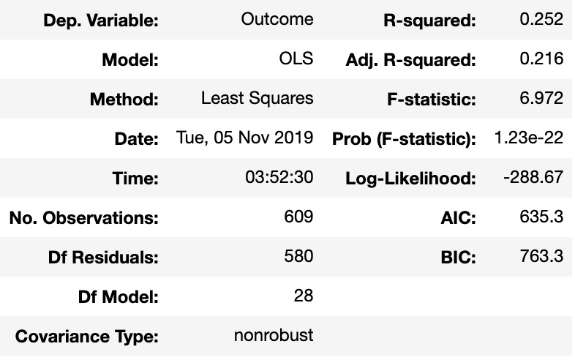
APPENDIX
Imputation : SK Learn iterative Imputer, Bayesian Ridge estimator : Ascending imputation
Reduced Feature set after OLS(Ordinary Least Squares) : 'Age’, 'BUN', 'Creatinine', 'DiasABP', 'FiO2', 'GCS', 'Glucose', 'HCO3’, 'HCT', 'HR', 'ICUType', 'K', 'MAP', 'Mg’, 'Na', 'PaCO2', 'PaO2', 'Platelets','Gender’, 'RecordID', 'SysABP', 'Temp', 'Urine', 'WBC', 'Weight', 'pH’.
3)
OLS Results :
4) XG Boost parameters : 'colsample_bytree': 1, 'gamma': 0, 'learning_rate': 0.06, 'max_depth': 5, 'subsample': 0.9

Slide 11
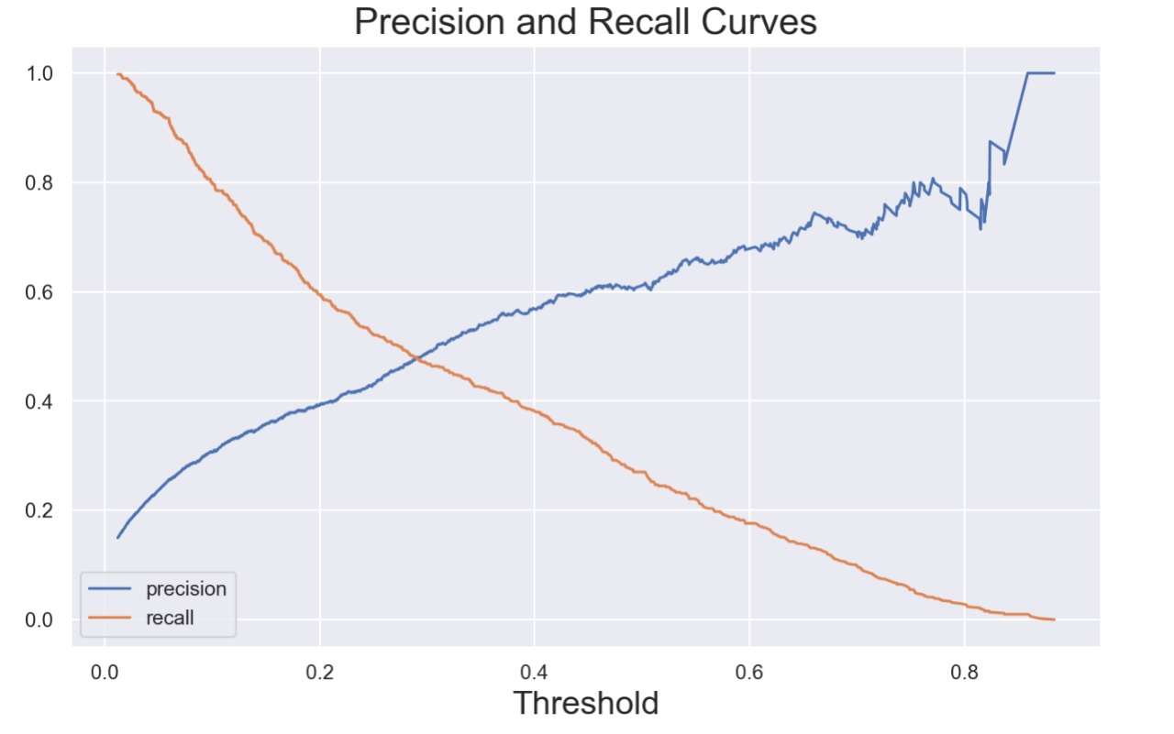
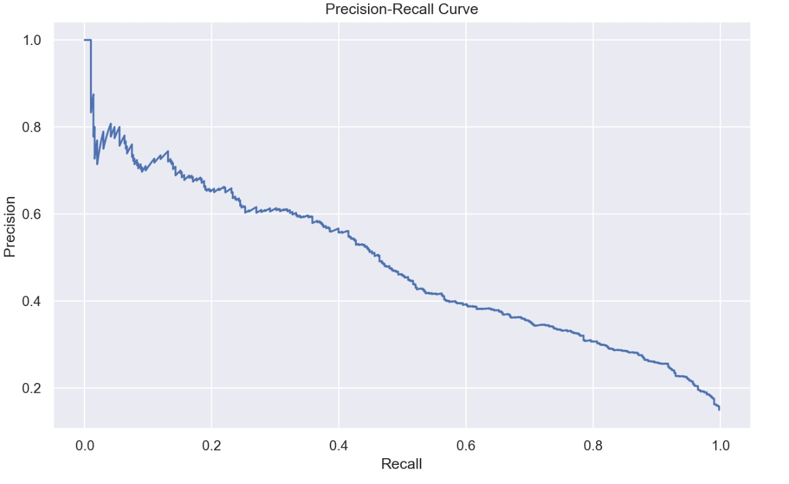
PRECISION RECALL CURVES

Slide 12
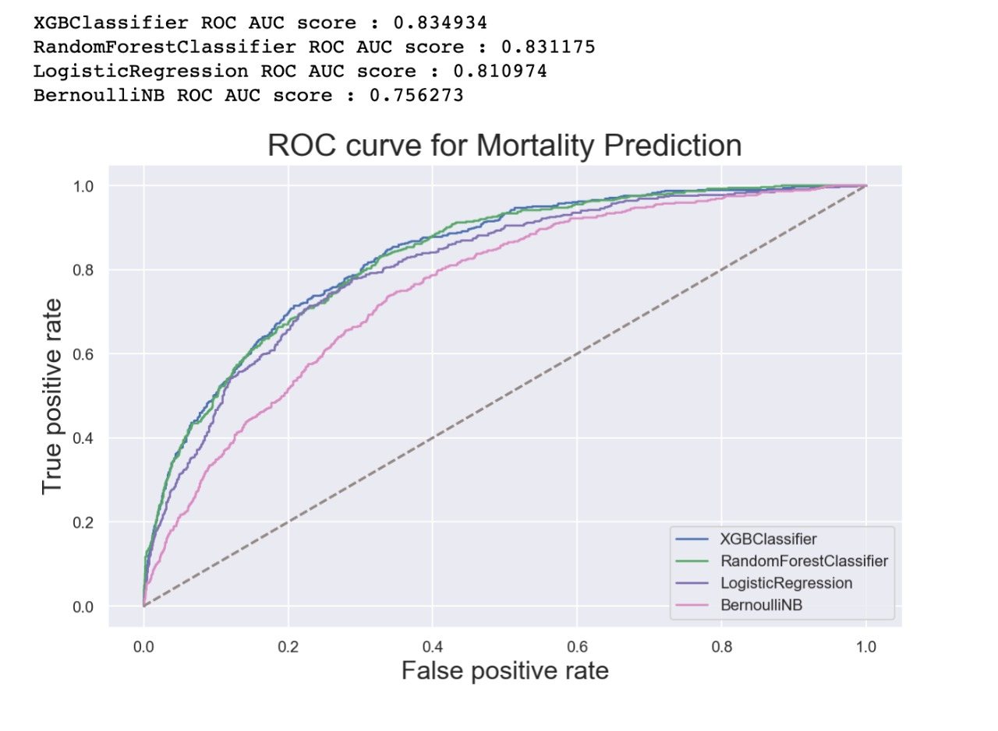
ROC & AUC Scores for various Models

Slide 13
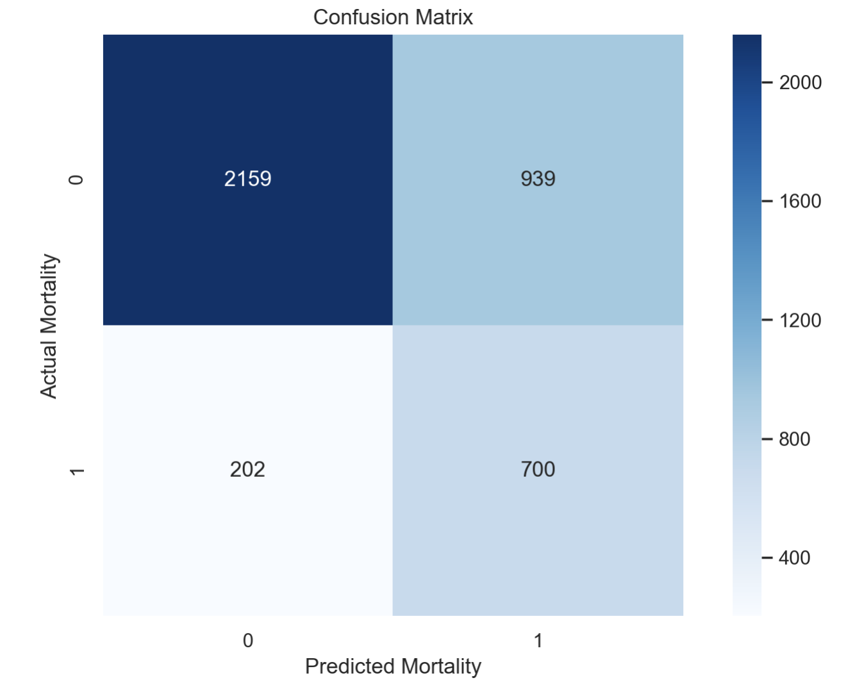
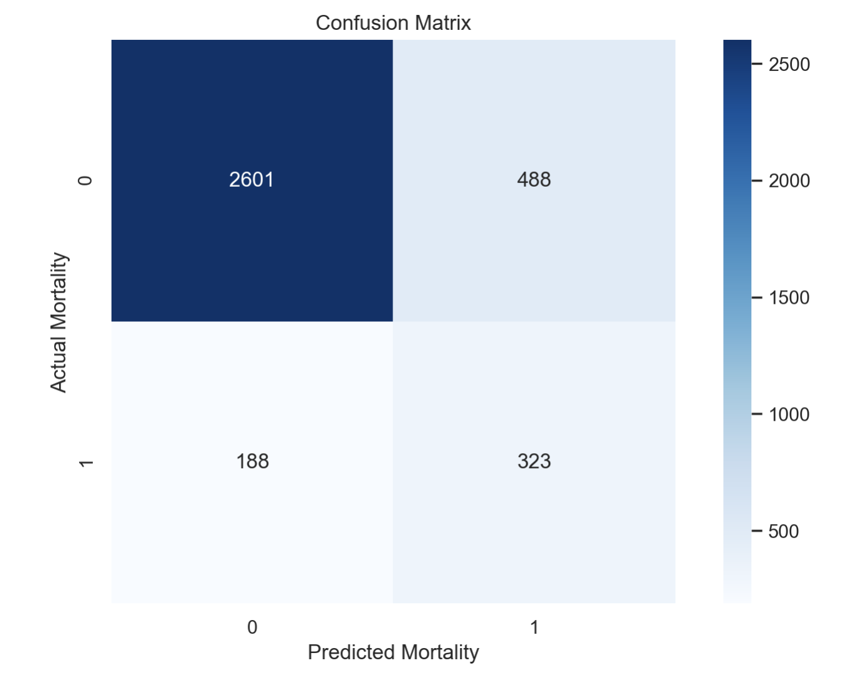
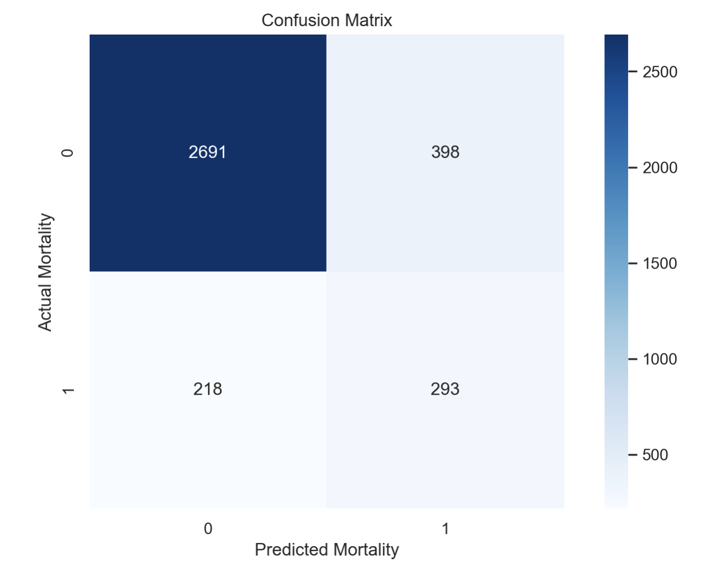
REDUCING THE FALSE POSTIVE RATE
Initial FPR (Raw Data)
Impute Using Bayesian Ridge
Use XGBoost Ensembling with Correlated Features Removed
FPR : 0.3
FPR : 0.15
FPR : 0.12

Slide 14




SWOT Analysis : Also a PRODUCT Roadmap
Action-able Insights
Low False Positive Rates
STRENGTHS
Cannot completely remove human Intervention
Under confident Predictions in case of less data
WEAKNESSES
Medical Research
AI in Health Care
OPPORTUNITIES
Too much Depende-ncy
New Medical Norms
THREATS

